Slide 1
BITS Pilani
Dr. Lavika Goel
Assistant Professor
Department of CSIS
Lecture 4: 10/2/2019
Pilani Campus

Slide 2
Pilani Campus
Index Construction
2/9/2019 SS ZG537 (INFORMATION RETRIEVAL) 2

Slide 3
Today’s Agenda
How do we construct an index?
What strategies can we use with limited main memory?
2/9/2019 SS ZG537 (INFORMATION RETRIEVAL) 3
Pilani Campus

Slide 4
Hardware basics
Many design decisions in information retrieval are based on the characteristics of hardware
We begin by reviewing hardware basics
2/9/2019 SS ZG537 (INFORMATION RETRIEVAL) 4
Pilani Campus

Slide 5
Hardware basics
Access to data in memory is much faster than access to data on disk.
Disk seeks: No data is transferred from disk while the disk head is being positioned.
Therefore: Transferring one large chunk of data from disk to memory is faster than transferring many small chunks.
Disk I/O is block-based: Reading and writing of entire blocks (as opposed to smaller chunks).
Block sizes: 8KB to 256 KB.
2/9/2019 SS ZG537 (INFORMATION RETRIEVAL) 5
Pilani Campus
Notes:
Seek Time
Rotational Delay
Transfer Delay

Slide 6
Hardware basics
Servers used in IR systems now typically have several GB of main memory, sometimes tens of GB.
Available disk space is several (2–3) orders of magnitude larger.
Fault tolerance is very expensive: It’s much cheaper to use many regular machines rather than one fault tolerant machine.
2/9/2019 SS ZG537 (INFORMATION RETRIEVAL) 6
Pilani Campus

Slide 7
Hardware assumptions for this lecture
symbol statistic value
s average seek time 5 ms = 5 x 10⁻³ s
b transfer time per byte 0.02 μs = 2 x 10⁻⁸ s
processor’s clock rate 10⁹ s⁻¹
p low-level operation 0.01 μs = 10⁻⁸ s
(e.g., compare & swap a word)
size of main memory several GB
size of disk space 1 TB or more
2/9/2019 SS ZG537 (INFORMATION RETRIEVAL) 7
Pilani Campus

Slide 8
RCV1: Our collection for this lecture
Shakespeare’s collected works definitely aren’t large enough for demonstrating many of the points in this course.
The collection we’ll use isn’t really large enough either, but it’s publicly available and is at least a more plausible example.
As an example for applying scalable index construction algorithms, we will use the Reuters RCV1 collection.
This is one year of Reuters newswire (part of 1995 and 1996)
2/9/2019 SS ZG537 (INFORMATION RETRIEVAL) 8
Pilani Campus

Slide 9
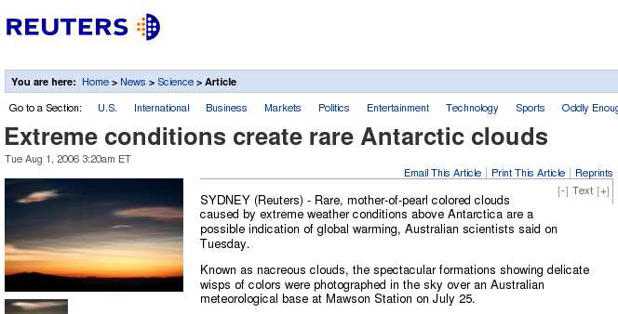
A Reuters RCV1 document
2/9/2019 SS ZG537 (INFORMATION RETRIEVAL) 9
Pilani Campus

Slide 10
Reuters RCV1 statistics
symbol statistic value
N documents 800,000
L avg. # tokens per doc 200
M terms (= word types) 400,000
avg. # bytes per token 6
(incl. spaces/punct.)
avg. # bytes per token 4.5
(without spaces/punct.)
avg. # bytes per term 7.5
non-positional postings 100,000,000
4.5 bytes per word token vs. 7.5 bytes per word type: why?
2/9/2019 SS ZG537 (INFORMATION RETRIEVAL) 10
Pilani Campus

Slide 11
Recall IIR 1 index construction
Documents are parsed to extract words and these are saved with the Document ID.
Doc 1
Doc 2
I did enact Julius
Caesar I was killed
i' the Capitol;
Brutus killed me.
So let it be with
Caesar. The noble
Brutus hath told you
Caesar was ambitious
2/9/2019 SS ZG537 (INFORMATION RETRIEVAL) 11
Pilani Campus

Slide 12
Key step
After all documents have been parsed, the inverted file is sorted by terms.
We focus on this sort step.
We have 100M items to sort.
2/9/2019 SS ZG537 (INFORMATION RETRIEVAL) 12
Pilani Campus

Slide 13
Scaling index construction
In-memory index construction does not scale
Can’t stuff entire collection into memory, sort, then write back
How can we construct an index for very large collections?
Taking into account the hardware constraints we just learned about . . .
Memory, disk, speed, etc.
2/9/2019 SS ZG537 (INFORMATION RETRIEVAL) 13
Pilani Campus

Slide 14
Sort-based index construction
As we build the index, we parse docs one at a time.
The final postings for any term are incomplete until the end.
At 8 bytes per non-positional postings entry (term, doc), demands a lot of space for large collections.
T = 100,000,000 in the case of RCV1
So … we can do this in memory in 2009, but typical collections are much larger. E.g., the New York Times provides an index of >150 years of newswire
Thus: We need to store intermediate results on disk.
2/9/2019 SS ZG537 (INFORMATION RETRIEVAL) 14
Pilani Campus
Notes:
4 bytes for Doc ID (because we have 8,00,000 doc ids)
4 bytes for termID (4,00,000 terms needs 4,00,00 ids)
1,00,000,000 * 8 bytes = 0.8 GB

Slide 15
Sort using disk as “memory”?
Can we use the same index construction algorithm for larger collections, but by using disk instead of memory?
No: Sorting T = 100,000,000 records on disk is too slow – too many disk seeks.
We need an external sorting algorithm.
2/9/2019 SS ZG537 (INFORMATION RETRIEVAL) 15
Pilani Campus

Slide 16
Bottleneck
Parse and build postings entries one doc at a time
Now sort postings entries by term (then by doc within each term)
Doing this with random disk seeks would be too slow – must sort T=100M records
If every comparison took 2 disk seeks, and N items could be
sorted with N log₂N comparisons, how long would this take?
2/9/2019 SS ZG537 (INFORMATION RETRIEVAL) 16
Pilani Campus
Notes:
N log N disk seeks with milli secs 100 million log l00 million ~ years

Slide 17
BSBI: Blocked sort-based Indexing (Sorting with fewer disk seeks)
8-byte (4+4) records (term, doc).
These are generated as we parse docs.
Must now sort 100M such 12-byte records by term ID.
Define a Block ~ 10M such records
Can easily fit a couple into memory.
Will have 10 such blocks to start with.
Basic idea of algorithm:
Accumulate postings for each block, sort, write to disk.
Then merge the blocks into one long sorted order.
2/9/2019 SS ZG537 (INFORMATION RETRIEVAL) 17
Pilani Campus

Slide 18
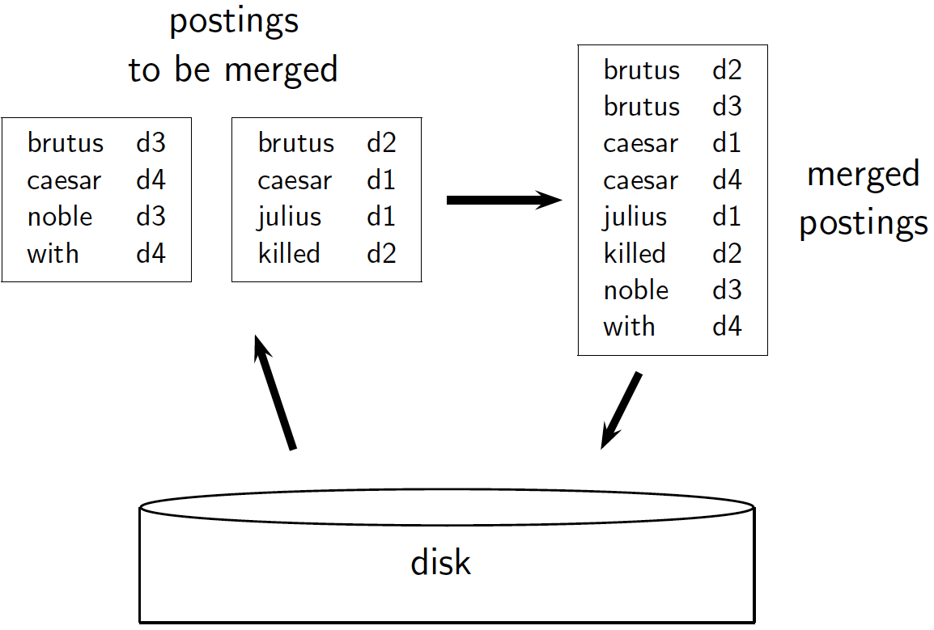
2/9/2019 SS ZG537 (INFORMATION RETRIEVAL) 18
Pilani Campus

Slide 19
Sorting 10 blocks of 10M records
First, read each block and sort within:
Quicksort takes 2N ln N expected steps
In our case 2 x (10M ln 10M) steps
Exercise: estimate total time to read each block from disk and and quicksort it.
10 times this estimate – gives us 10 sorted runs of 10M records each.
Done straightforwardly, need 2 copies of data on disk
But can optimize this
2/9/2019 SS ZG537 (INFORMATION RETRIEVAL) 19
Pilani Campus

Slide 20
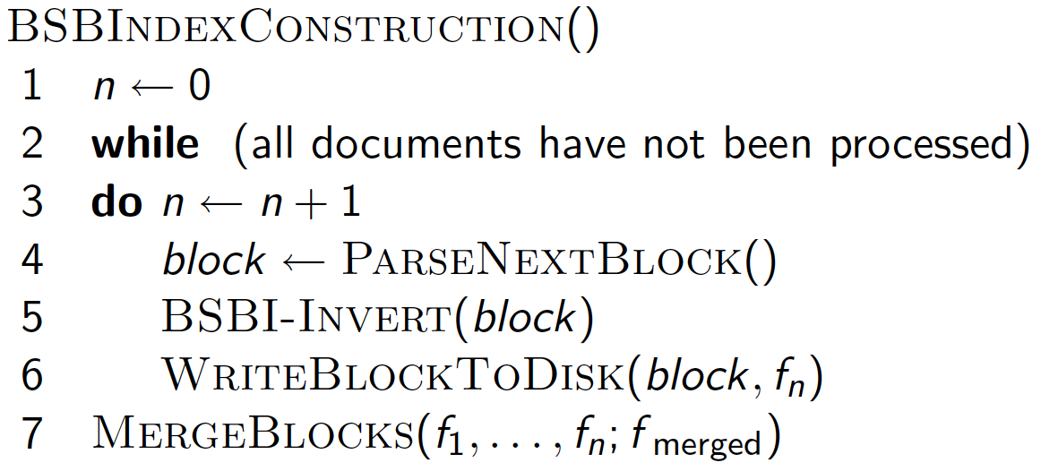
2/9/2019 SS ZG537 (INFORMATION RETRIEVAL) 20
Pilani Campus

Slide 21
How to merge the sorted runs?
Can do binary merges, with a merge tree of log₂10 = 4 layers.
During each layer, read into memory runs in blocks of 10M, merge, write back.
1
1
2
2
Merged run.
3
4
3
4
Runs being
merged.
Disk
2/9/2019 SS ZG537 (INFORMATION RETRIEVAL) 21
Pilani Campus

Slide 22
How to merge the sorted runs?
But it is more efficient to do a multi-way merge, where you are reading from all blocks simultaneously
Providing you read decent-sized chunks of each block into memory and then write out a decent-sized output chunk, then you’re not killed by disk seeks
2/9/2019 SS ZG537 (INFORMATION RETRIEVAL) 22
Pilani Campus

Slide 23
Remaining problem with sort-based algorithm
Our assumption was: we can keep the dictionary in memory.
We need the dictionary (which grows dynamically) in order to implement a term to termID mapping.
Actually, we could work with term,docID postings instead of termID,docID postings . . .
. . . but then intermediate files become very large. (We would end up with a scalable, but very slow index construction method.)
2/9/2019 SS ZG537 (INFORMATION RETRIEVAL) 23
Pilani Campus

Slide 24
SPIMI: Single-pass in-memory indexing
Key idea 1: Generate separate dictionaries for each block – no need to maintain term-termID mapping across blocks.
Key idea 2: Don’t sort. Accumulate postings in postings lists as they occur.
With these two ideas we can generate a complete inverted index for each block.
These separate indexes can then be merged into one big index.
2/9/2019 SS ZG537 (INFORMATION RETRIEVAL) 24
Pilani Campus

Slide 25
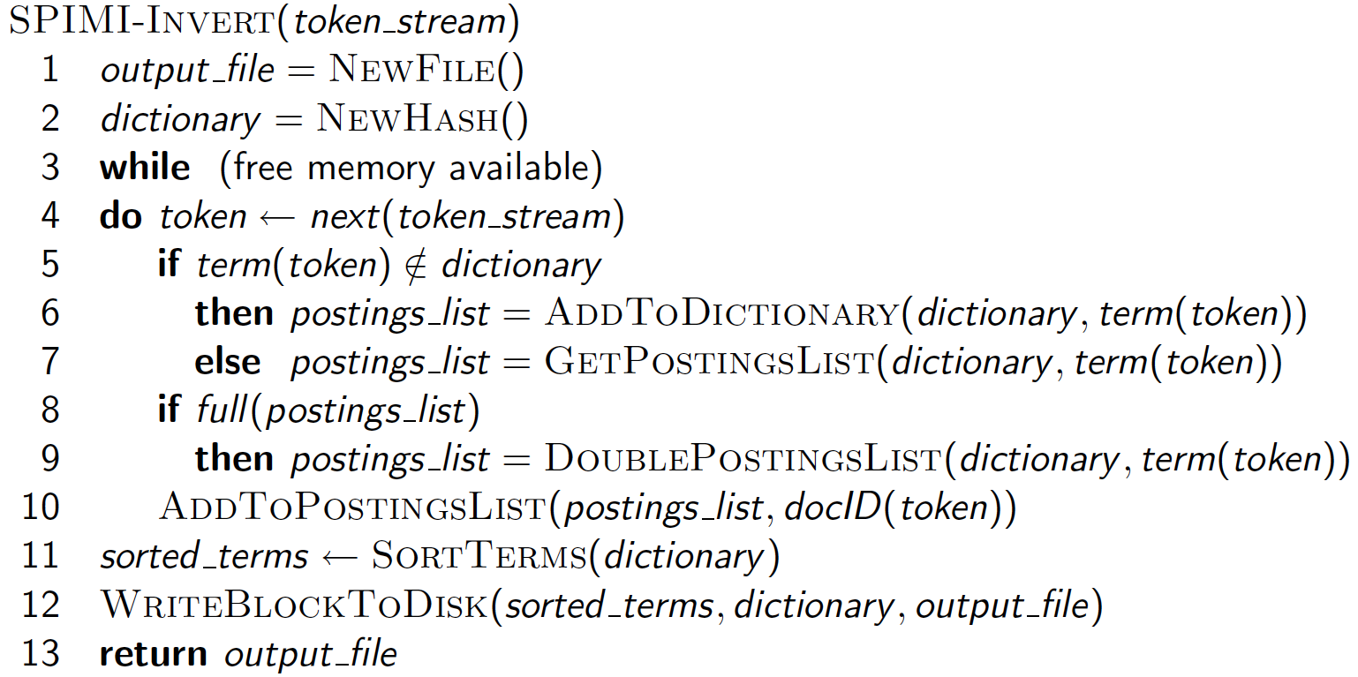
SPIMI-Invert
Merging of blocks is analogous to BSBI.
2/9/2019 SS ZG537 (INFORMATION RETRIEVAL) 25
Pilani Campus

Slide 26
Distributed indexing
Maintain a master machine directing the indexing job – considered “safe”.
Break up indexing into sets of (parallel) tasks.
Master machine assigns each task to an idle machine from a pool.
2/9/2019 SS ZG537 (INFORMATION RETRIEVAL) 26
Pilani Campus

Slide 27
Distributed indexing
For web-scale indexing
must use a distributed computing cluster
Individual machines are fault-prone
Can unpredictably slow down or fail
How do we exploit such a pool of machines?
2/9/2019 SS ZG537 (INFORMATION RETRIEVAL) 27
Pilani Campus

Slide 28
Google data centers
https://www.google.com/videohp?gws_rd=ssl
Google data centers mainly contain commodity machines.
Data centers are distributed around the world.
Estimate: a total of 1 million servers, 3 million processors/cores (Gartner 2007)
Estimate: Google installs 100,000 servers each quarter.
Based on expenditures of 200–250 million dollars per year
This would be 10% of the computing capacity of the world!?!
2/9/2019 SS ZG537 (INFORMATION RETRIEVAL) 28
Pilani Campus

Slide 29
Parallel tasks
We will use two sets of parallel tasks
Parsers
Inverters
Break the input document collection into splits
Each split is a subset of documents (corresponding to blocks in BSBI/SPIMI)
2/9/2019 SS ZG537 (INFORMATION RETRIEVAL) 29
Pilani Campus

Slide 30
Parsers
Master assigns a split to an idle parser machine
Parser reads a document at a time and emits (term, doc) pairs
Parser writes pairs into j partitions
Each partition is for a range of terms’ first letters
(e.g., a-f, g-p, q-z) – here j = 3.
Now to complete the index inversion
2/9/2019 SS ZG537 (INFORMATION RETRIEVAL) 30
Pilani Campus

Slide 31
Inverters
An inverter collects all (term,doc) pairs (= postings) for one term-partition.
Sorts and writes to postings lists
2/9/2019 SS ZG537 (INFORMATION RETRIEVAL) 31
Pilani Campus

Slide 32
Data flow
assign
Master
assign
Postings
Parser
a-f
g-p
q-z
Inverter
a-f
Parser
a-f
g-p
q-z
Inverter
g-p
splits
Inverter
q-z
Parser
a-f
g-p
q-z
Map
phase
Reduce
phase
Segment files
2/9/2019 SS ZG537 (INFORMATION RETRIEVAL) 32
Pilani Campus

Slide 33
MapReduce
The index construction algorithm we just described is an instance of MapReduce.
MapReduce (Dean and Ghemawat 2004) is a robust and conceptually simple framework for distributed computing …… without having to write code for the distribution part.
They describe the Google indexing system (ca. 2002) as consisting of a number of phases, each implemented in MapReduce.
2/9/2019 SS ZG537 (INFORMATION RETRIEVAL) 33
Pilani Campus

Slide 34
MapReduce
Index construction was just one phase.
Another phase: transforming a term-partitioned index into a document-partitioned index.
Term-partitioned: one machine handles a subrange of terms
Document-partitioned: one machine handles a subrange of documents
2/9/2019 SS ZG537 (INFORMATION RETRIEVAL) 34
Pilani Campus

Slide 35
Dynamic indexing
Up to now, we have assumed that collections are static.
They rarely are:
Documents come in over time and need to be inserted.
Documents are deleted and modified.
This means that the dictionary and postings lists have to be modified:
Postings updates for terms already in dictionary
New terms added to dictionary
2/9/2019 SS ZG537 (INFORMATION RETRIEVAL) 35
Pilani Campus

Slide 36
Simplest approach
Maintain “big” main index
New docs go into “small” auxiliary index
Search across both, merge results
Deletions
Invalidation bit-vector for deleted docs
Filter docs output on a search result by this invalidation bit-vector
Periodically, re-index into one main index
2/9/2019 SS ZG537 (INFORMATION RETRIEVAL) 36
Pilani Campus

Slide 37
Issues with main and auxiliary indexes
Problem of frequent merges – you touch stuff a lot
Poor performance during merge
Actually:
Merging of the auxiliary index into the main index is efficient if we keep a separate file for each postings list.
Merge is the same as a simple append.
But then we would need a lot of files – inefficient for OS.
Assumption for the rest of the lecture: The index is one big file.
In reality: Use a scheme somewhere in between (e.g., split very large postings lists, collect postings lists of length 1 in one file etc.)
2/9/2019 SS ZG537 (INFORMATION RETRIEVAL) 37
Pilani Campus

Slide 38
Logarithmic merge
Maintain a series of indexes, each twice as large as the previous one.
Keep smallest (Z₀) in memory
Larger ones (I₀, I₁, …) on disk
If Z₀ gets too big (> n), write to disk as I₀
or merge with I₀ (if I₀ already exists) as Z₁
Either write merge Z₁ to disk as I₁ (if no I₁)
Or merge with I₁ to form Z₂ etc.
2/9/2019 SS ZG537 (INFORMATION RETRIEVAL) 38
Pilani Campus

Slide 39
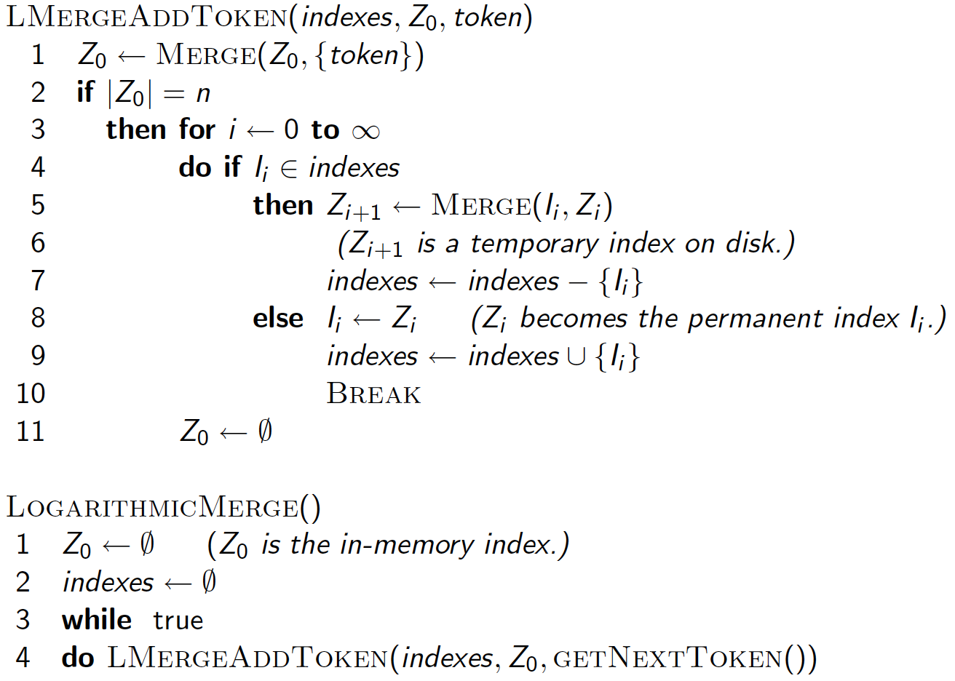
2/9/2019 SS ZG537 (INFORMATION RETRIEVAL) 39
Pilani Campus

Slide 40
Logarithmic merge
Auxiliary and main index: index construction time is O(T²) as each posting is touched in each merge.
Logarithmic merge: Each posting is merged O(log T) times, so complexity is O(T log T)
So logarithmic merge is much more efficient for index construction
But query processing now requires the merging of O(log T) indexes
Whereas it is O(1) if you just have a main and auxiliary index
2/9/2019 SS ZG537 (INFORMATION RETRIEVAL) 40
Pilani Campus

Slide 41
Dynamic indexing at search engines
All the large search engines now do dynamic indexing
Their indices have frequent incremental changes
News items, blogs, new topical web pages
Sarah Palin, …
But (sometimes/typically) they also periodically reconstruct the index from scratch
Query processing is then switched to the new index, and the old index is then deleted
2/9/2019 SS ZG537 (INFORMATION RETRIEVAL) 41
Pilani Campus

Slide 42
Take home message
The index construction mainly requires the dictionary to be in the main memory but today’s existing RAM capacity is not sufficient.
We need external sorting algorithms and the main constraint in these algorithms is to minimize the number of disk seeks.
BSB index construction
SPIMI index construction
Dynamic indexing is built using the Logarithmic merge
2/9/2019 SS ZG537 (INFORMATION RETRIEVAL) 42
Pilani Campus

